Slide 1

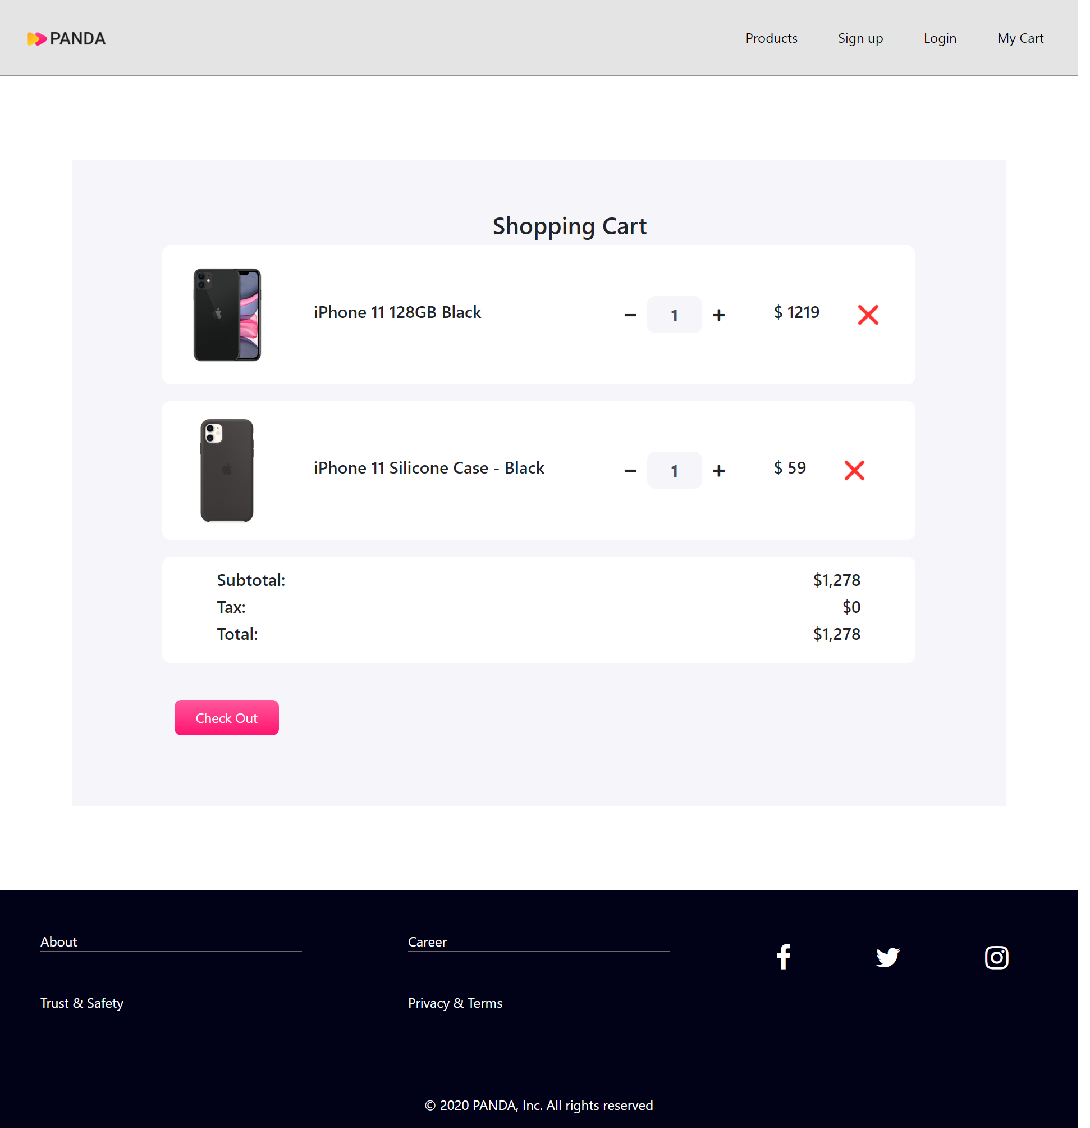
Homepage
Cart page

Slide 2
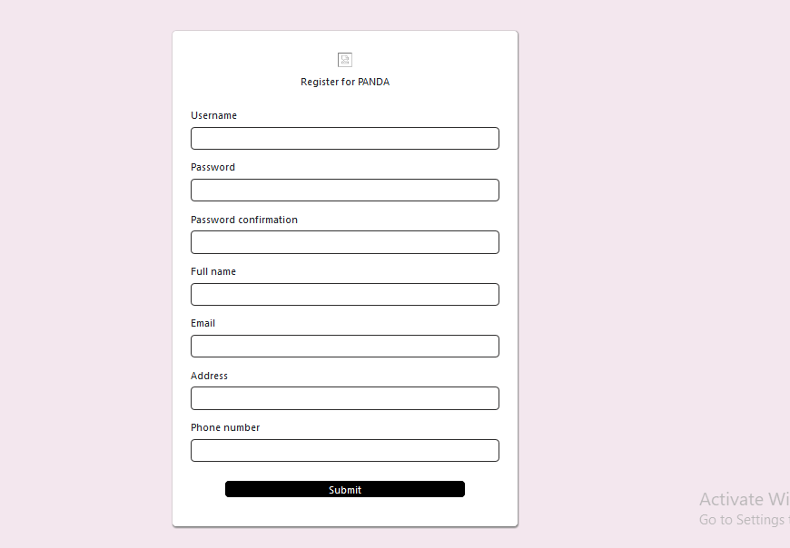
Registration page

Slide 3
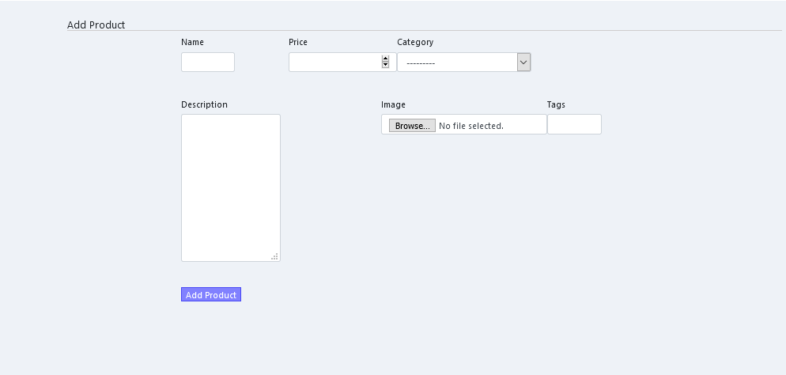
Product add page

Slide 4

Seller Product list page

Slide 5
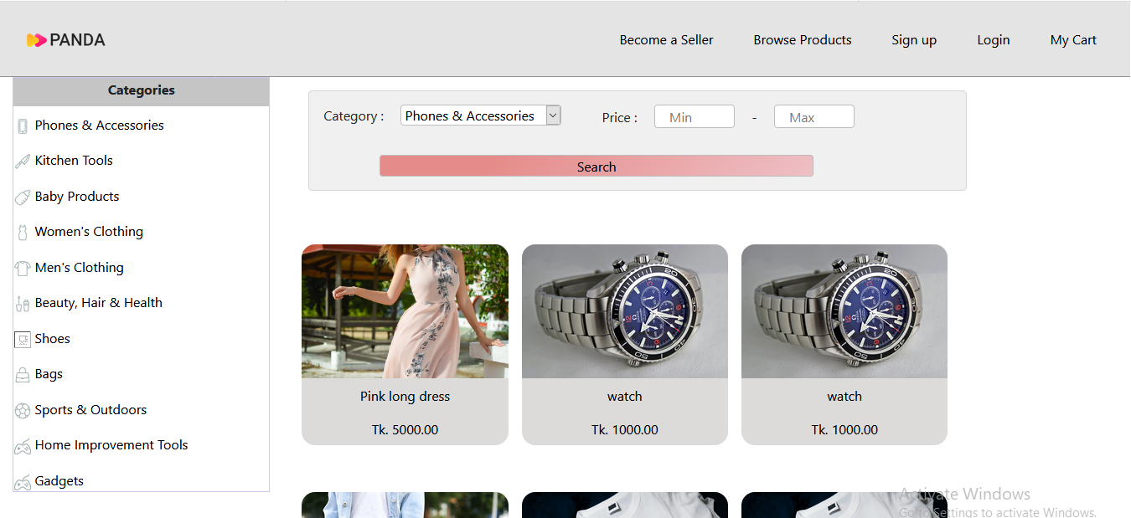
Product list page

Slide 6
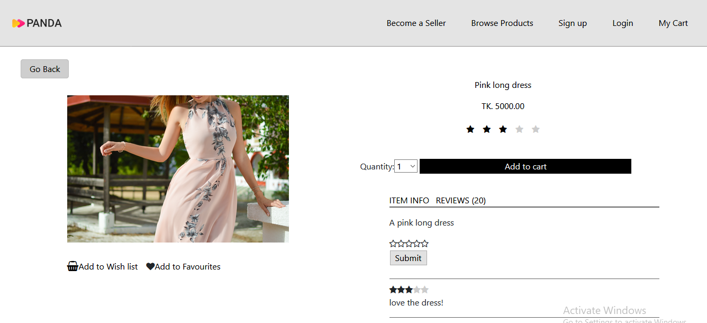
Single Product page

Slide 7
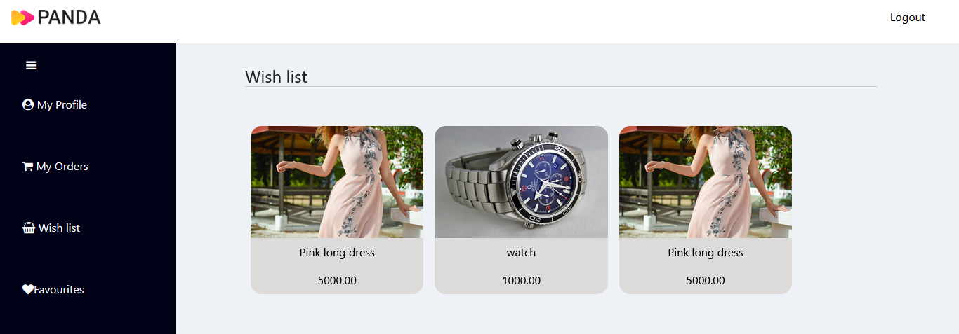
User Dashboard page

Slide 8
Cart page

Slide 9
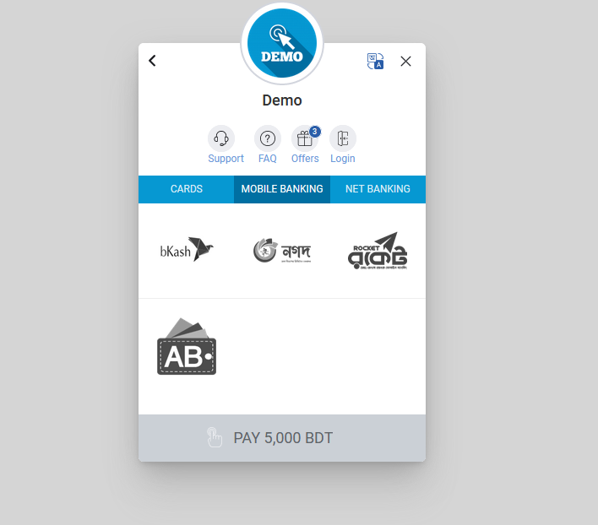
Payment gateway page

